Slide 1
Group 4: Singapore History-Based Trivia Chatbot
Muhammad Azreen Bin Muhammad
Justin Tan Yong An
Leong Tuck Ming Kenan
Wong Jun Kai
Chan Jit Lin
Notes:
Good morning, everyone. We are Group 4, and today we’ll be presenting our Singapore History-Based Trivia Chatbot. Our team members are Azreen, Justin, myself, Jun Kai, and Jit.

Slide 2
Background
Singapore's historical resources remain largely untapped due to accessibility challenges and traditional presentation formats, creating an opportunity for technology-enhanced engagement with the nation's rich past.
Tourism Support: Offer tourists deeper context about historical sites, cultural practices, and significant events beyond what standard guidebooks provide.
Personalization Need: Current historical education approaches often follow standardized formats, whereas a RAG-powered chatbot can deliver customized historical content based on individual interests, knowledge levels, and learning objectives.
Lack of awareness: People in general might not have much interest outside of their formal education, regarding Singapore’s history
Notes:
Singapore’s rich history is often overlooked due to accessibility challenges and outdated presentation methods.
Our chatbot aims to enhance engagement by providing interactive and personalized historical content.
There are three key issues:
Tourists lack deep insights into historical sites beyond guidebooks.
Historical education is standardized and not tailored to individual interests.
Many people lose interest in Singapore’s history after formal education.

Slide 3
Solution
Develop a personalized NLP learning assistant specializing in Singapore’s history.
The system will leverage the SIT library to create an engaging and educational platform delivering accurate and well-sourced historical information through interactive conversations
The chat-bot utilizes a fine tuned model based on the dataset as well as Retrieval-Augmented Generation (RAG) technology.
Notes:
Our solution is an AI-powered chatbot specializing in Singapore’s history which we downloaded the entire model, not just calling an api key which gives us full customisation of it.
It personalizes learning using NLP and RAG.
Built on the SIT library, it delivers well-sourced historical content.
The chatbot integrates a fine-tuned model and retrieval-augmented generation to ensure accuracy and engagement.

Slide 4
Evaluation of Models Used
Name | Model Size | Inference Rating
Opt1.3 | 1.3 Billion
Mistral3B | 3 Billion
Mistral7B | 7 Billion
Deepseek-LLM-7B-Chat | 7 Billion
T5-Small | 60 Million
Meta-Llama-3-8B | 8 Billion
Phi3 Mini Instruct | 3.8 Billion
Notes:
These are the models that we experimented with and we discovered that phi3 mini has the best inference rating which refers to the performance of each model during real-time execution or prediction. However, it has a long training time given the computing resources we have. My teammate azreen will elaborate more on this.

Slide 5

Model of choice Phi 3.5 Unsloth Variant

Slide 6
Model of choice Phi 3.5 Unsloth Variant
Open Source and Community-Driven: Unsloth is freely available as open-source, allowing immediate access to its capabilities. A strong community drives its continuous improvement, and users can find extensive resources, including benchmarks and reproducible notebooks, on GitHub and the Unsloth blog.
Speed and Efficiency: Unsloth.ai can accelerate the fine-tuning process up to 30 times compared to traditional methods. This is achieved without compromising accuracy, thanks to manual differentiation and optimized GPU kernels. For instance, tasks typically taking 23 hours on a Tesla T4 GPU can be completed in just over 2 hours using Unsloth​.
Memory Optimization: Unsloth offers significant memory optimization, enabling users to process larger datasets and utilize extended context windows. By reducing peak memory consumption by up to 74%, it facilitates the fine-tuning of substantial models even on systems with constrained hardware resources.

Slide 7
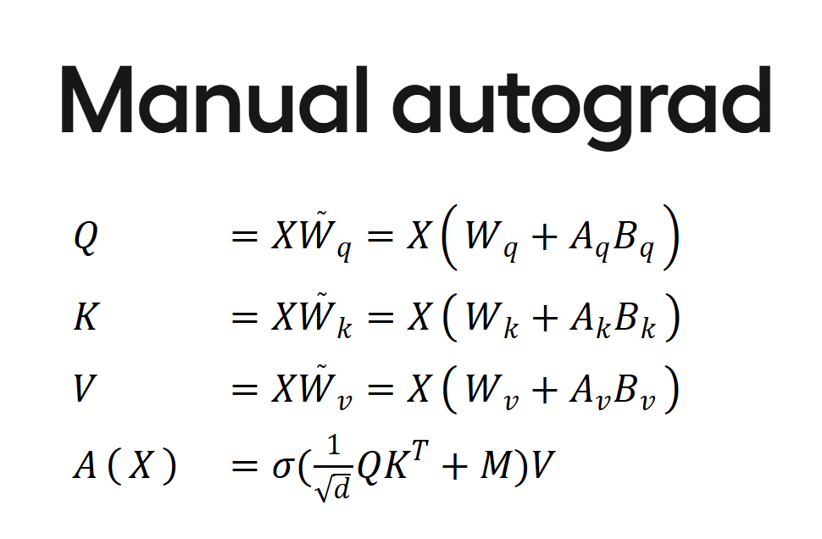
Model of choice Phi 3.5 Unsloth Variant
Unsloth.ai uses advanced mathematical derivations and handwritten GPU kernels using OpenAI’s Triton language​​. Pytorch autograd is reasonably efficient for most tasks, but if you want extreme performance, you have to derive the matrix differentials yourself. Sloth optimizes it for us by fine-tuning by manually deriving matrix differentials and performing chained matrix multiplications. This approach ensures that operations are carried out with minimal computational overhead.

Slide 8
LoRA Learns Less and Forgets Less
A key advantage of LoRA is its ability to preserve the pre-trained LLM's general knowledge while adapting it to the chatbot's specific domain.
This mitigates catastrophic forgetting, ensuring that the chatbot maintains its ability to handle a wide range of user queries beyond its specialized tasks.
This allows for faster experimentation cycles, as the reduced training time enabled rapid testing of different fine-tuning parameters and datasets.

Slide 9
RAG
Supplements our fine tuning of the model.
RAG provides transparency by allowing users to trace the source of the chatbot's information, increasing accountability and confidence in its responses.
RAG allows for the processing of very large datasets, that would be impossible to finetune into a model. This allows for a much larger context window in a way.
RAG minimizes the need to retrain the base LLM with new data, saving time and computational resources, especially when dealing with frequently updated information.

Slide 10
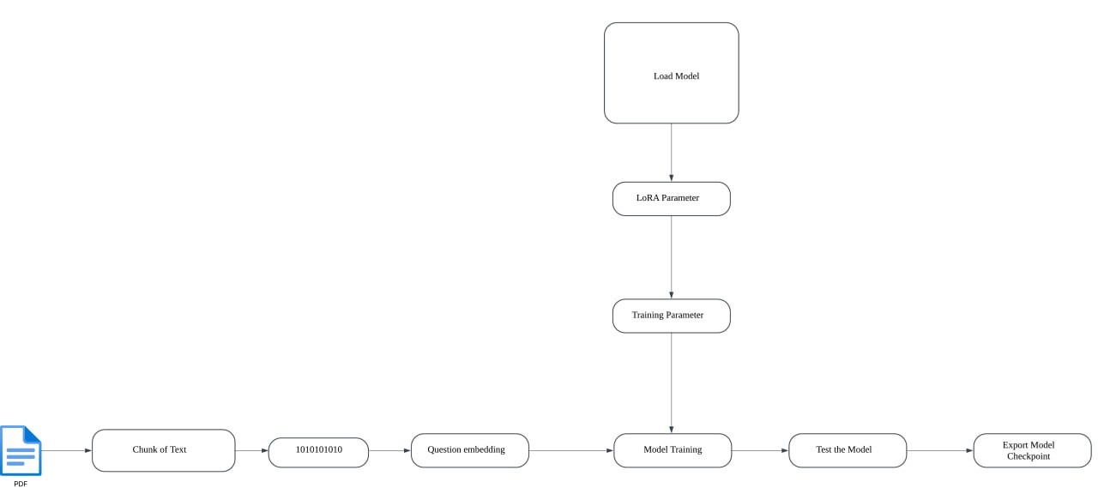
Langchain Pipeline Training

Slide 11
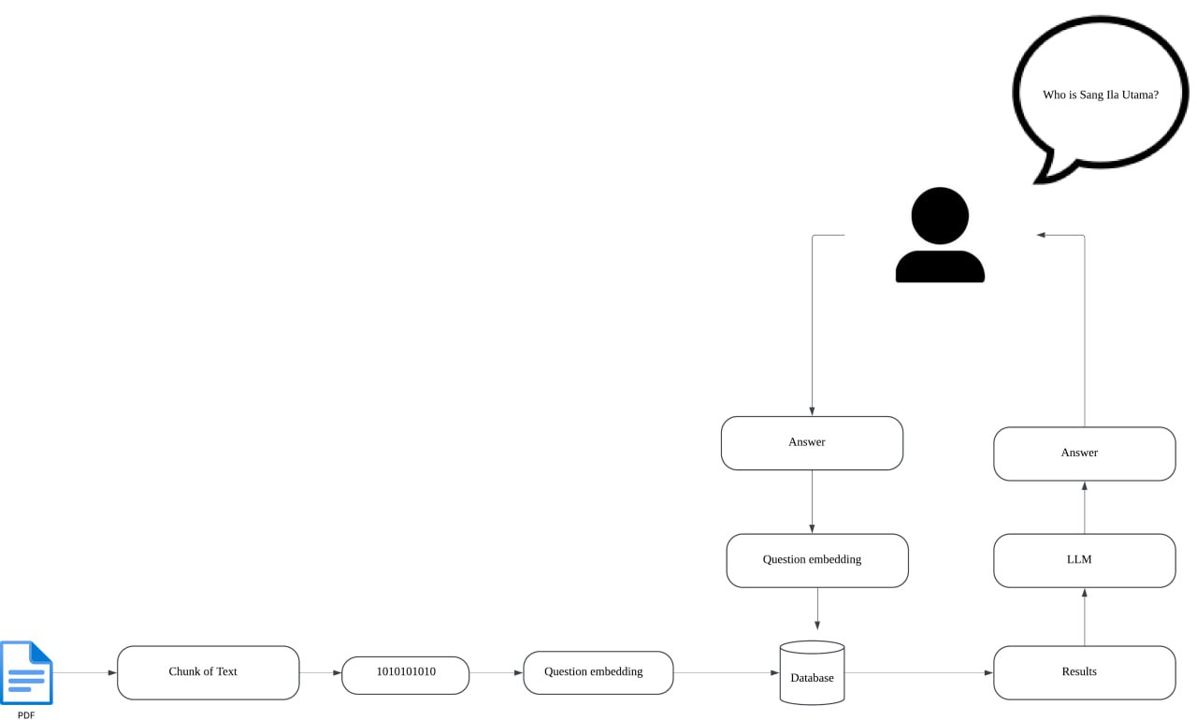
Langchain Pipeline Inference

Slide 12
Guardrail integration(to prevent hallucination)
To maintain within scope, we implemented a guardrail:
Comprehensive Lexicon: The guardrail contains 100+ Singapore-specific historical terms (including historical figures like "Lee Kuan Yew," events like "Japanese Occupation," and landmarks like "Fort Canning") to identify relevant queries.
Non-History Term Detection: The system maintains a separate lexicon of 300+ non-historical terms across categories like food, sports, and technology to identify off-topic questions, preventing the model from generating responses outside its knowledge domain.
Weighted Decision Logic: When processing user queries, the guardrail performs comparative analysis between history-related and non-history terms,choosing based on term prevalence to determine if a question falls within scope.
Notes:
To prevent hallucinations and keep responses relevant, we implemented a term-based guardrail. It uses a Comprehensive Lexicon of 100+ Singapore history terms, a Non-History Term Detector to filter unrelated queries, and Weighted Decision Logic to balance between history-related and off-topic terms. This ensures our chatbot stays focused while avoiding overly strict filtering
We chose term-based over hardcoding full questions because:
Flexibility: Users phrase questions differently, and keyword matching adapts better.
Scalability: Updating keyword lists is easier than maintaining a database of fixed questions.
Efficiency: Quick filtering without complex processing.
Guardrail Strictness – Pros & Cons
Too strict → May wrongly reject valid questions, frustrating users.
Too loose → Risk of off-topic answers and hallucinations.
Our weighted decision logic helps maintain the right balance."

Slide 13
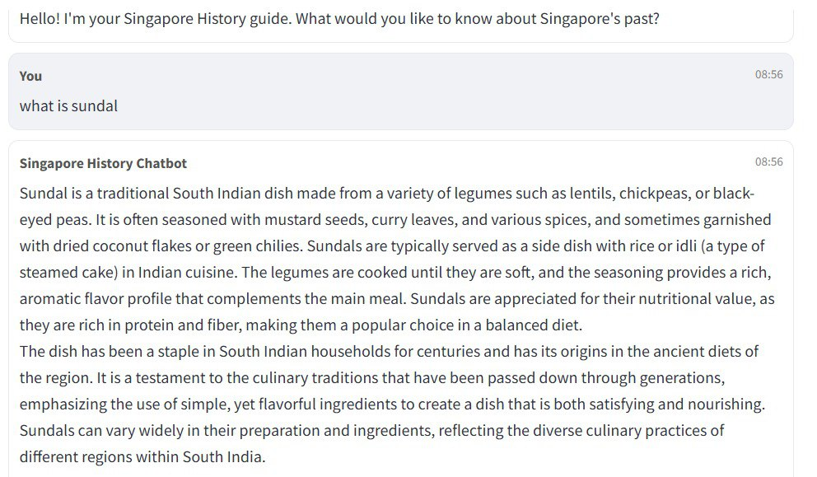
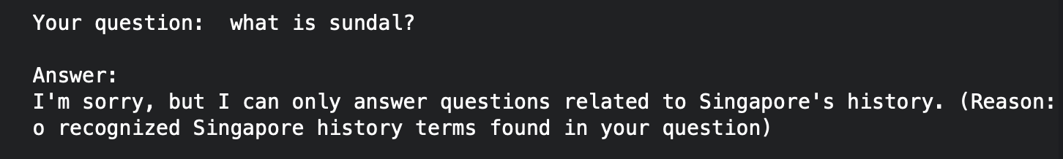
Guardrail integration Example
Before
After

Slide 14
ChatGPT Usage
Code Structure: Assisted in making the structure of the training code when evaluating models
Guardrail Expansion: Expanded the list of whitelisted and blacklisted words with the help of ChatGPT

Slide 15
DEMO

Slide 16

THANK YOU

Slide 17
HuggingFace hosted Front End
Deployment: Hosted on Hugging Face Spaces for accessibility and scalability
Model Integration: Connects to Phi-3.5-mini-instruct via the Hugging Face API
Intuitive Chat Interface: Clearly distinguished user/bot messages with timestamps
Contextual Guidance: Sidebar with suggested topics and conversation starters
Responsive Feedback: Visual "Thinking..." indicators during information retrieval

Slide 18
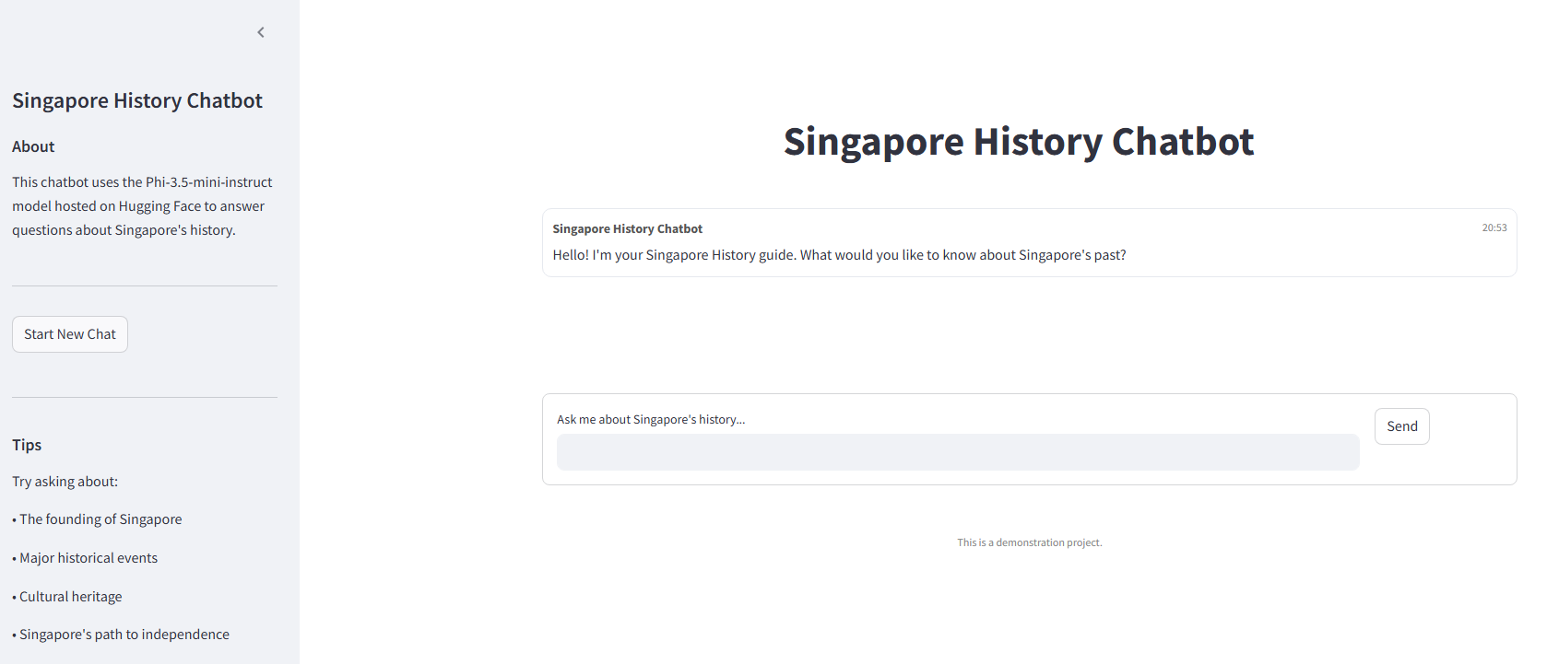
Frontend
Streamlit for their simplicity, interactivity, and fast deployment capabilities.
Minimalistic and user friendly UI.
Easy deployment from Hugging Face.

